Slide 1
Seismic Preparedness for
the General Public Using Virtual Reality:
Literature Review
Presented by Chen Zhao, Edwin Roesli

Slide 2


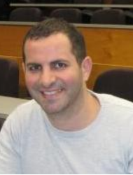

Our Research Team
Student
Student
Main Supervisor
Co-supervisor
Chen Zhao
Edwin Roesli
Nasser Giacaman
Quincy Ma

Slide 3
Objective of Our Research
Hazard Identification in Earthquake Preparedness.
Why hazard identification?
Hazards cause injuries to people.
Hazards cause damages to structures.

Slide 4
Background
Earthquake
Virtual Reality
Serious Gaming

Slide 5
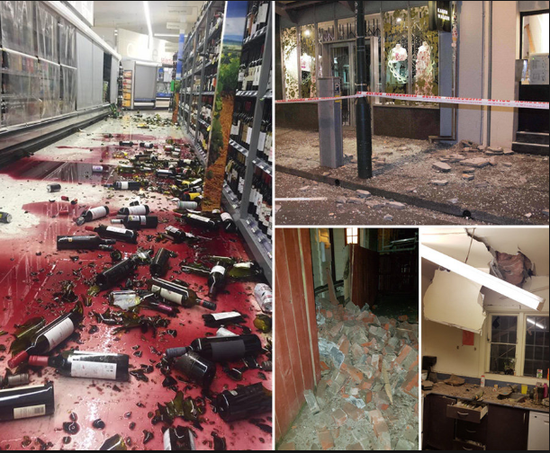
Earthquake
What is an earthquake?
Why do earthquakes cause damage?
The importance of earthquake preparedness

Slide 6
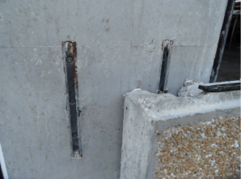
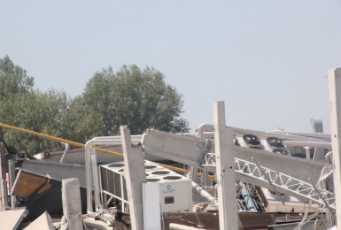
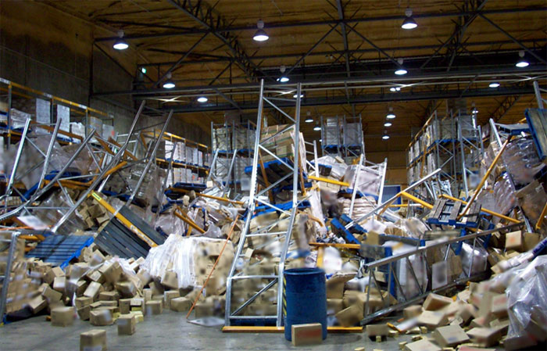
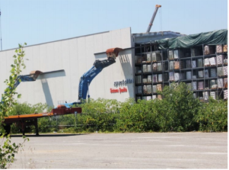
Earthquake
Effects on Structural Elements
Effects on Non-structural Elements
Connection Failures
Loss Support Failure
Racks Failures
Cladding Panel Failures
[1] N. Helm, Seismic performance of non-structural systems. Poriria, New Zealand: BRANZ Ltd, 2018.

Slide 7
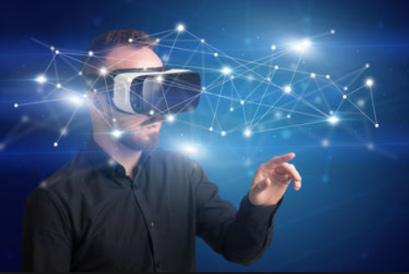
Virtual Reality
What is virtual reality (VR)?
What are the common types of VR ?
What can VR bring to the user?

Slide 8
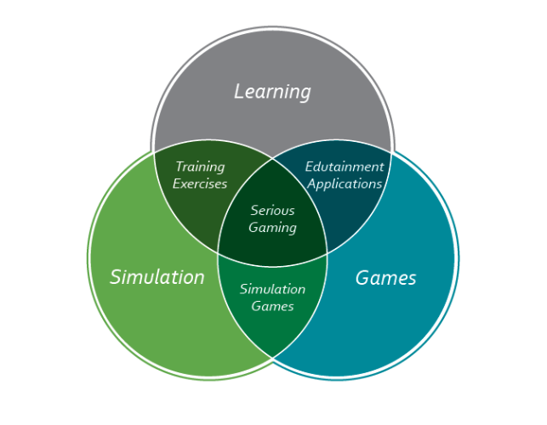
Serious Gaming
What is Serious Gaming?
Advantages of Serious Gaming
[38] D. R. Michael and S. L. Chen, Serious Games: Games That Educate, Train, and Inform. Muska and Lipman/Premier-Trade, 2005.

Slide 9
Related Work
VR simulations and its advantages
Earthquake Simulations
Earthquake Evacuation drills
Notes:
Edwin’s Section

Slide 10
VR simulations
Previous work:
Endoscopic simulator [1]
Human anatomy simulator [2]
Advantages:
Interaction
Imagination
Immersive
[1] I. White, B. Buchberg, V. Tsikitis, D. Herzig, J. Vetto, and K. Lu, A virtual reality endoscopic simulator augments general surgery resident cancer education as measured by performance improvement, Journal of Cancer Education, vol. 29, no. 2, pp. 333336, 2014.
[2] H.-M. Huang, U. Rauch, and S.-S. Liaw, Investigating learners' attitudes toward virtual reality learning environments: Based on a constructivist approach, Computers and Education, vol. 55, no. 3, pp. 11711182, 2010.
Notes:
Ian White, surgery (specifically Colorectal cancer) They tested time for completion of surgery (4.4 vs. 6.8 min,), and discomfort of patients (decrease in patients who felt a mild-moderate and extreme-severe pain)
Hsiu-Mei Huang, Questionnaire results mentions the Interaction and imagination is a big factor of VR. 3d interactive model of the human anatomy helped visualise and have a better understanding of the relative positions of parts.

Slide 11
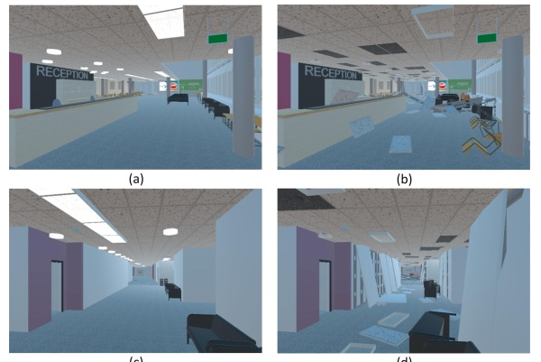
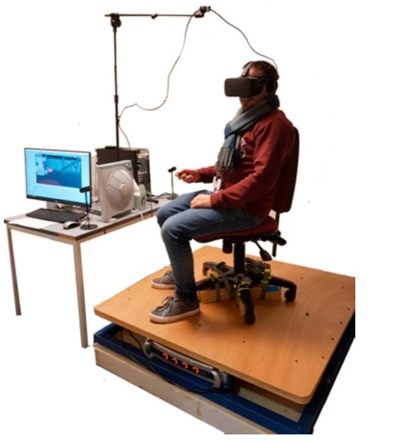
Earthquake simulations
Simulation based around the Auckland hospital [1].
Behavioural prototype, used to see how people behave during an earthquake using non-playable-characters (NPC)
Training prototype to teach best practices
Chair shaking system also implemented to add to the immersive nature of VR
[1] R. Lovreglio, V. Gonzalez, Z. Feng, R. Amor, M. Spearpoint, J. Thomas, M. Trotter, and R. Sacks, Prototyping virtual reality serious games for building earthquake preparedness: The auckland city hospital case study, Advanced Engineering Informatics

Slide 12
Earthquake evacuation drills
Preparation and planning during an earthquake
Aims to reduce the fear of uncertainty and lack of knowledge
Provides that randomness of never knowing when it may occur
Disadvantages:
Participants treated the drills as a compulsory exercise with little meaning [1]
Lack of immersion
[1] D. M. Simpson, Earthquake drills and simulations in community-based training and preparedness programmes, Disasters, vol. 26, no. 1, pp. 5569, 2002.

Slide 13
Discussion
Gap between related literature and our Project
Some of the technologies mentioned are not readily attainable
Most implementations focuses on reactiveness rather than proactiveness
Serious gaming concepts to boost users confidence
Research intent
Research the effectiveness of a virtual reality tool on a user's preparedness in an earthquake compared to traditional means such as reading hazard guides
Research the effect on confidence of a user’s ability to identify hazards before and after using a virtual reality tool

Slide 14
Summary
Earthquake, virtual reality and serious game concepts
Importance of hazard identification on Earthquake Preparedness
Previous literature and implementations
Research intent

Slide 15

Questions????

